Slide 1

Analysis of Daily YouTube Usage vs Step Counts Sarp Yılmaz
Notes:
Welcome to our presentation on the analysis of daily YouTube usage and its correlation with step counts. In today’s digital age, understanding how our online consumption affects our physical activity levels is crucial. This presentation aims to explore these dynamics, shedding light on the relationship between how we engage with media and our activity levels.

Slide 2
Hypothesis
Null Hypothesis (H₀): There is no significant association between daily YouTube usage and step counts.
Alternative Hypothesis (H₁): Significant correlations exist,

Slide 3
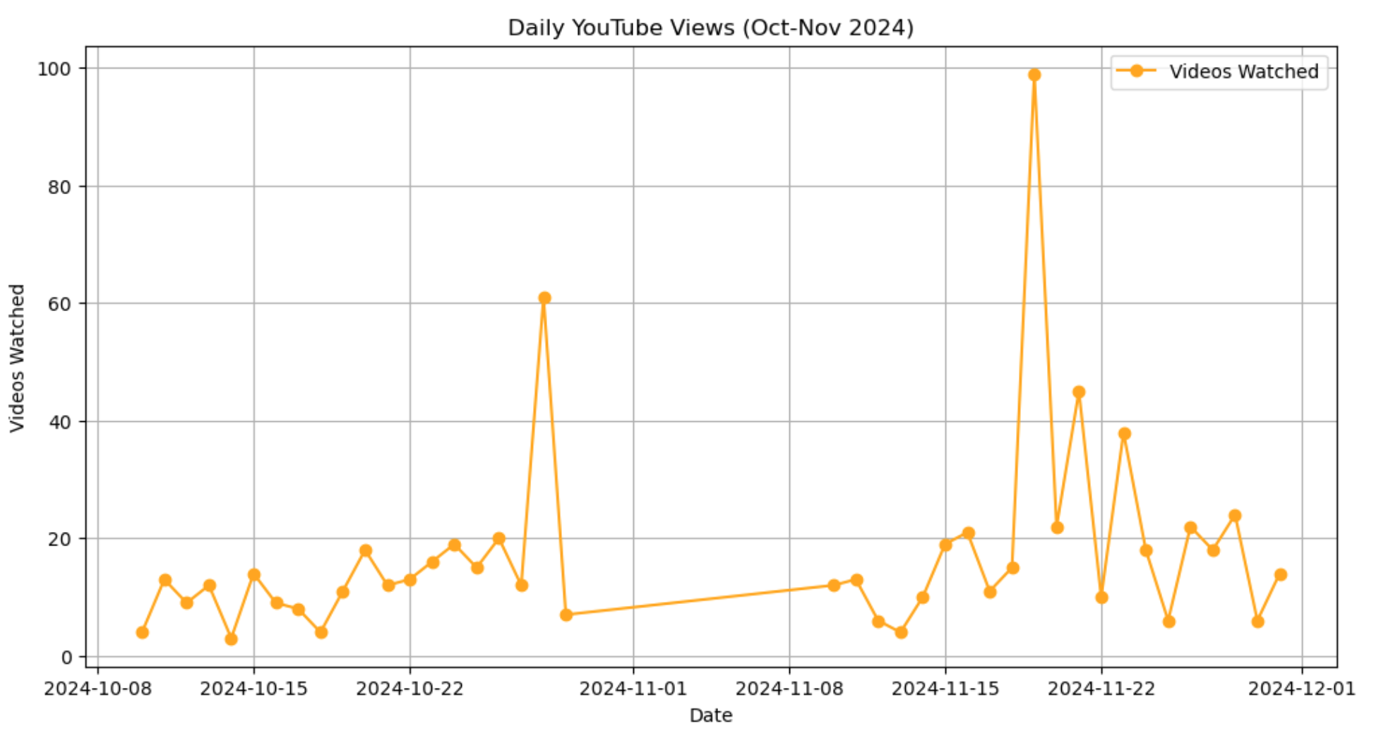
Daily YouTube Views
Visualization of Daily Usage: Graphical data displays fluctuations in daily YouTube views, providing an overview of user engagement patterns.
Data Period: The data analyzed spans two months, October to November 2024, capturing a range of viewing behaviors.
Trends in Consumption: Identification of key trends such as peak usage days, reflecting societal behaviors influencing content consumption.
Photo by Alexander Grey on Unsplash

Slide 4
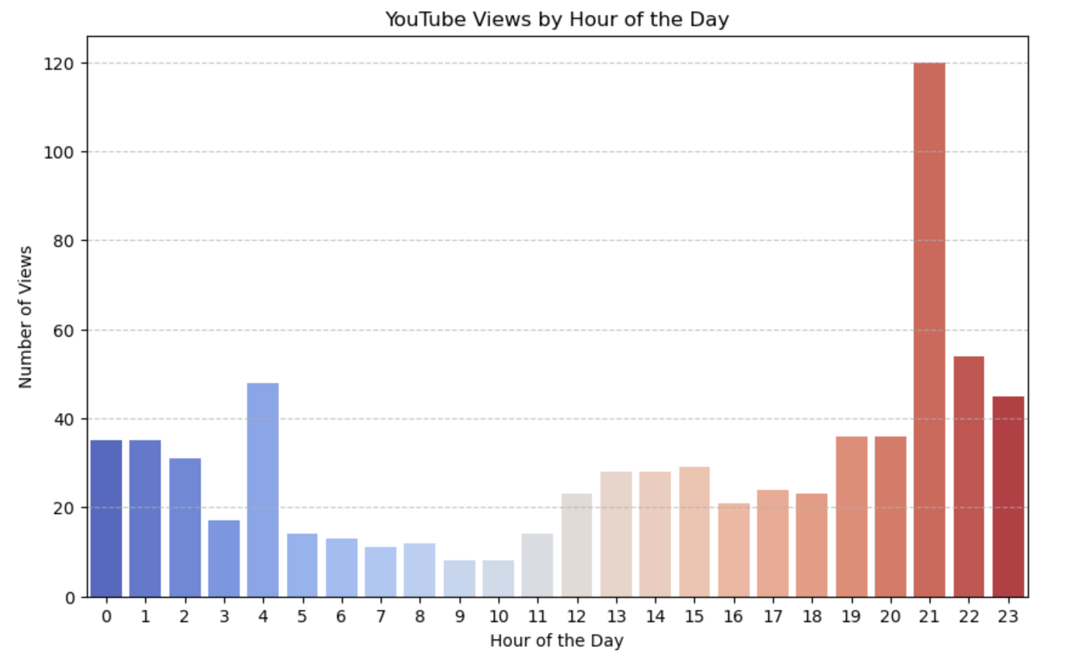
Hourly YouTube Views
Hourly Visualization: A bar chart detailing the distribution of views across different hours of the day, offering insights into viewing habits.
Usage Patterns: Identification of high engagement times where user activity peaks, facilitating deeper analysis of evening versus morning consumption.
Peak Hours Comparison: Delineation of viewing habits during weekday versus weekend rates, highlighting significant differences in consumption behaviors.

Slide 5
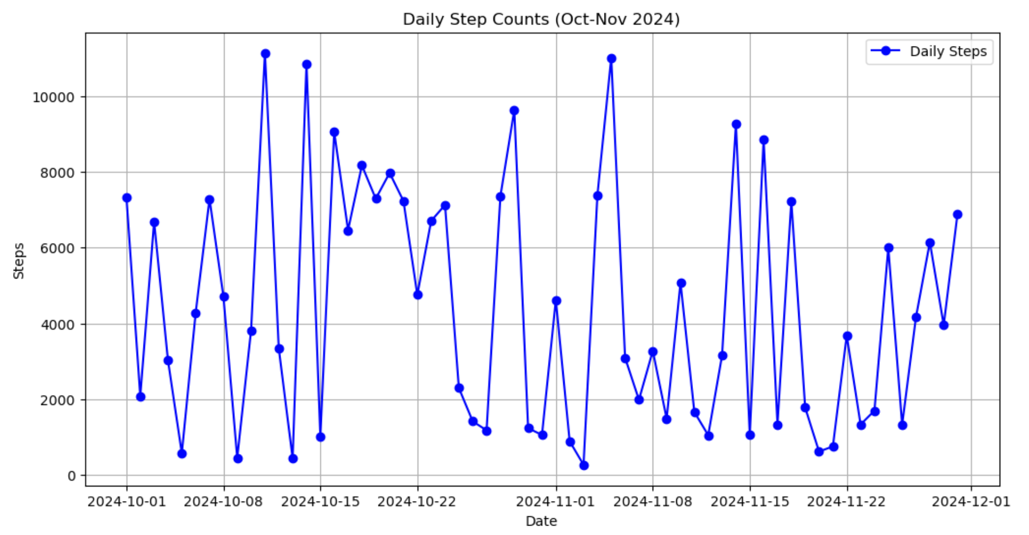
Daily Step Counts
Visualization of Activity Levels: A line graph encapsulating daily step counts, offering a visual representation of physical activity fluctuations over the study period.
Data Collection Period: Consistent tracking of daily step counts during October-November 2024, ensuring robust data for analysis.
Trends in Physical Activity: Analysis of observed trends and their potential implications for lifestyle choices and health outcomes.

Slide 6
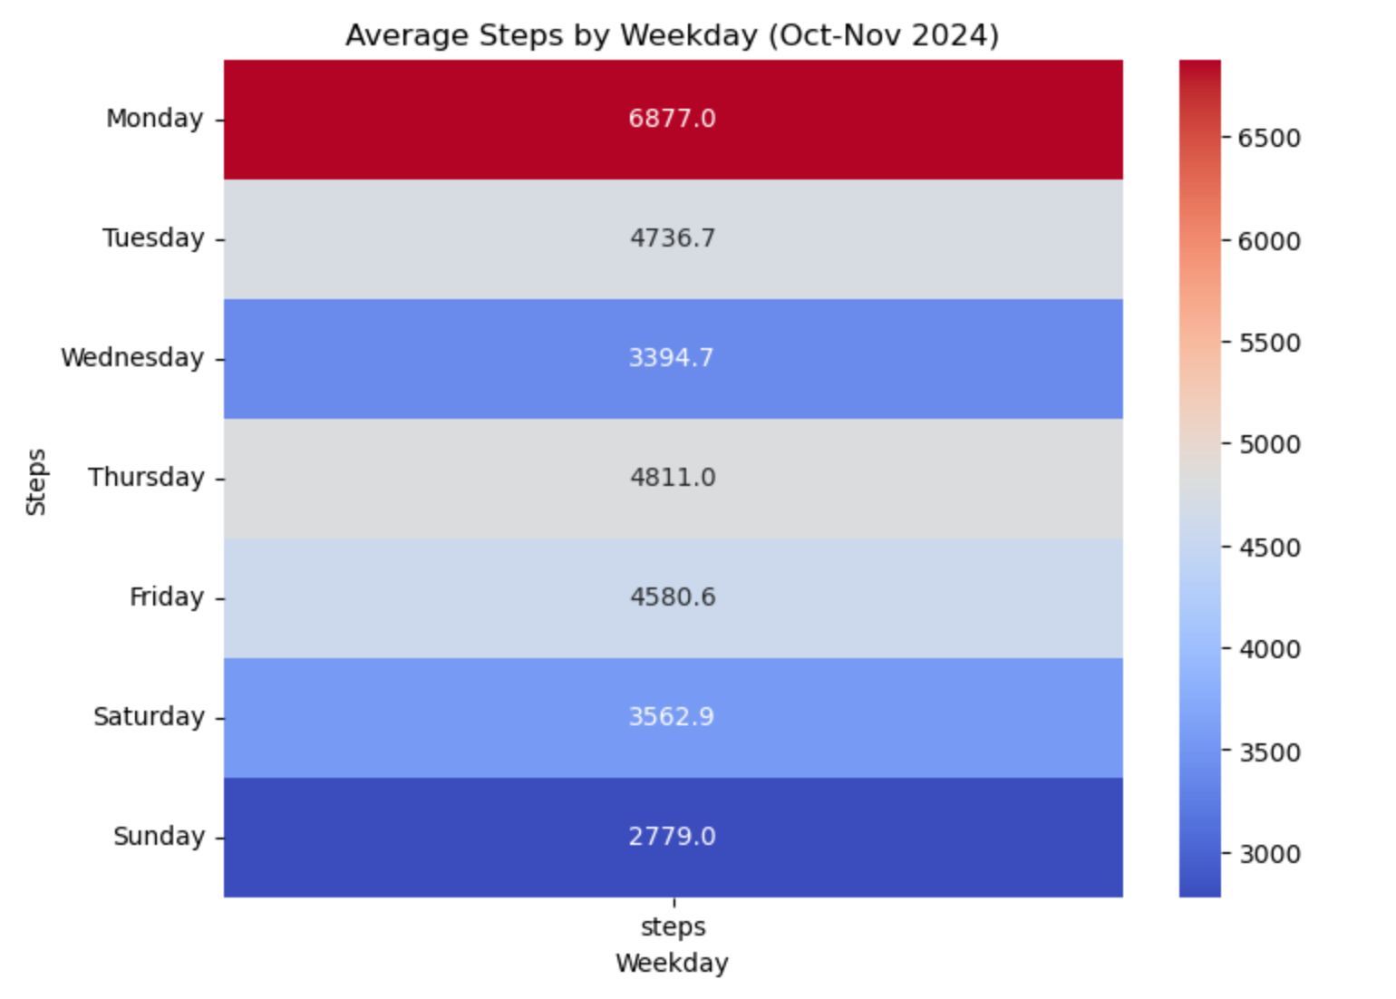
Steps by Weekday
Average Step Analysis: Evaluation of average daily steps categorized by the day of the week, giving insight into activity fluctuations based on typical weekly routines.
Bar Chart Visualization: A simple yet effective bar graph that highlights which weekdays users tend to be more or less active.
Activity Level Patterns: Identification of days with heightened activity, potentially correlating these trends with lower digital consumption.
Photo by Alora Griffiths on Unsplash
Notes:
In analyzing steps by weekday through bar charts, we can make sense of how physical activity is influenced by typical weekly schedules. Understanding these patterns is fundamental as we search for correlations between physical activity and media consumption.

Slide 7
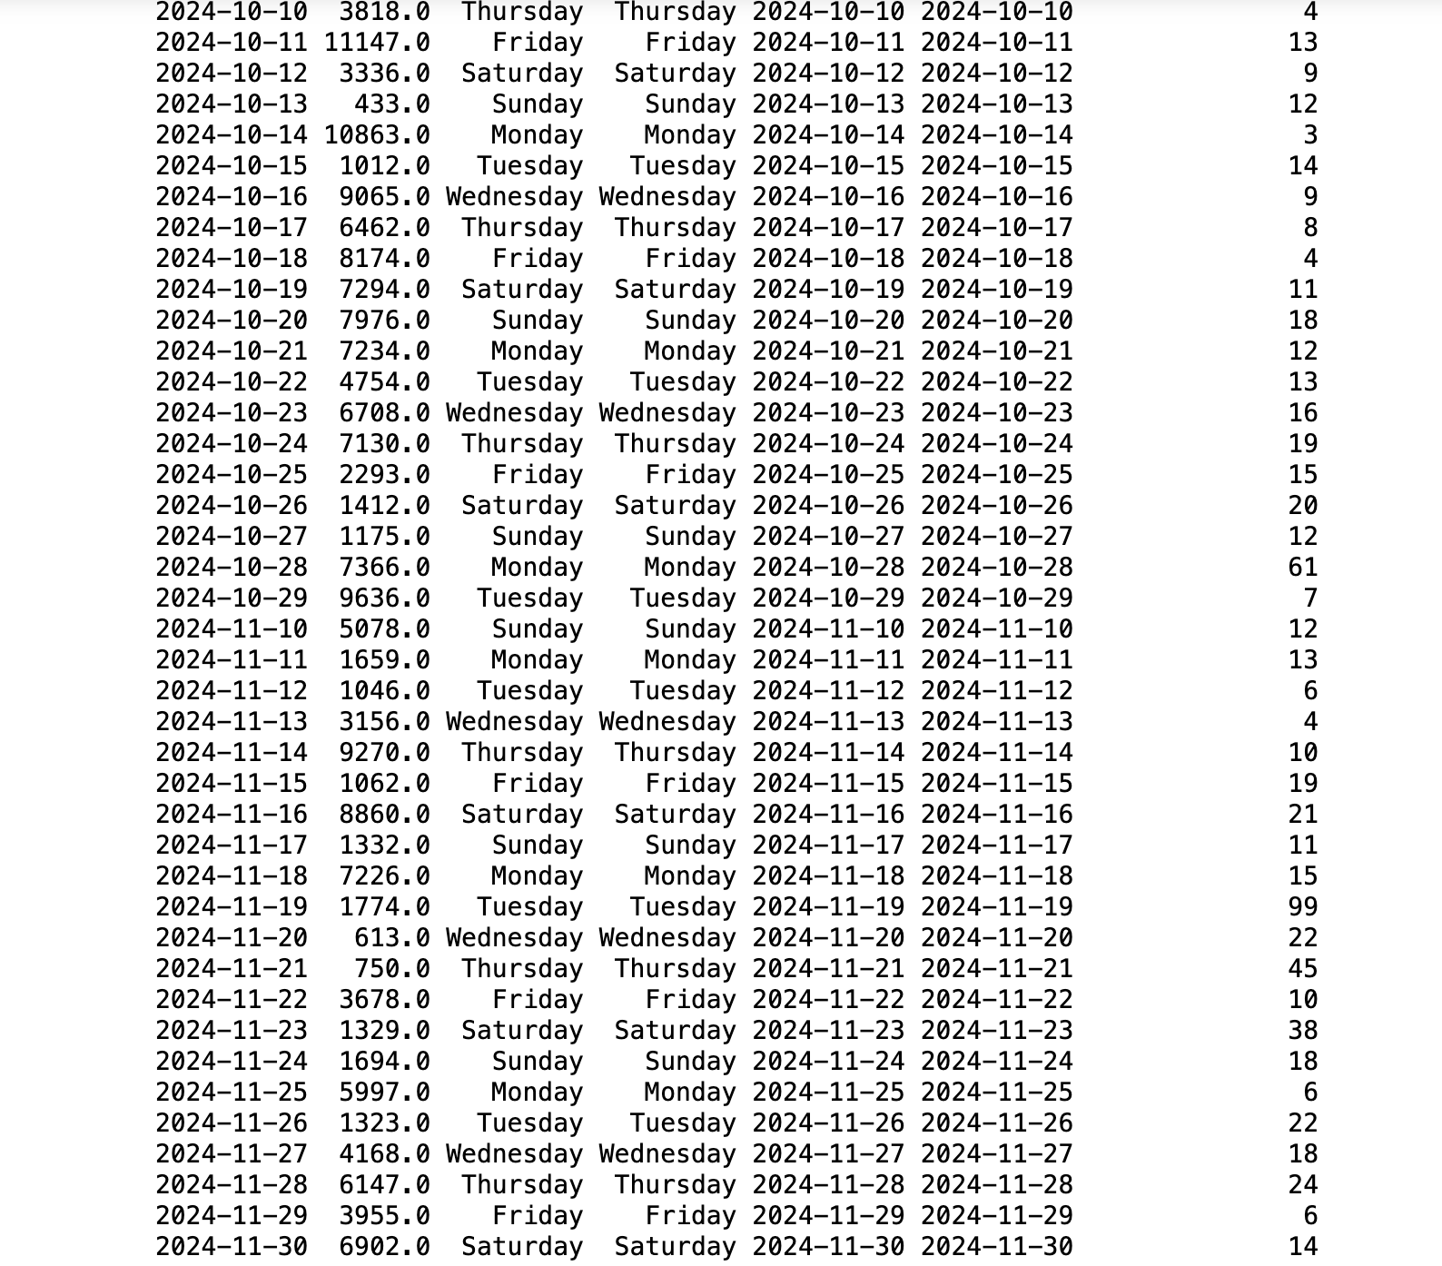
Merged data

Slide 8
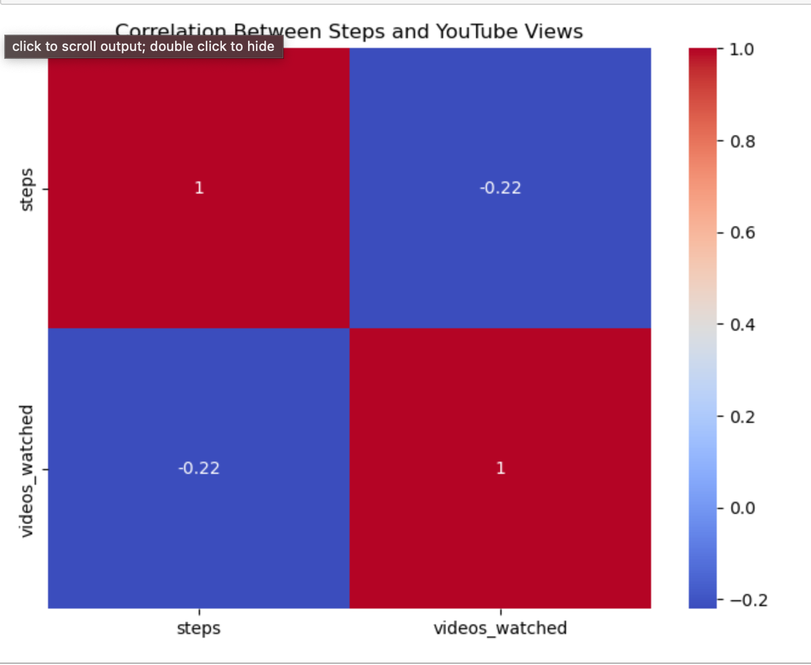
Correlation Matrix

Slide 9



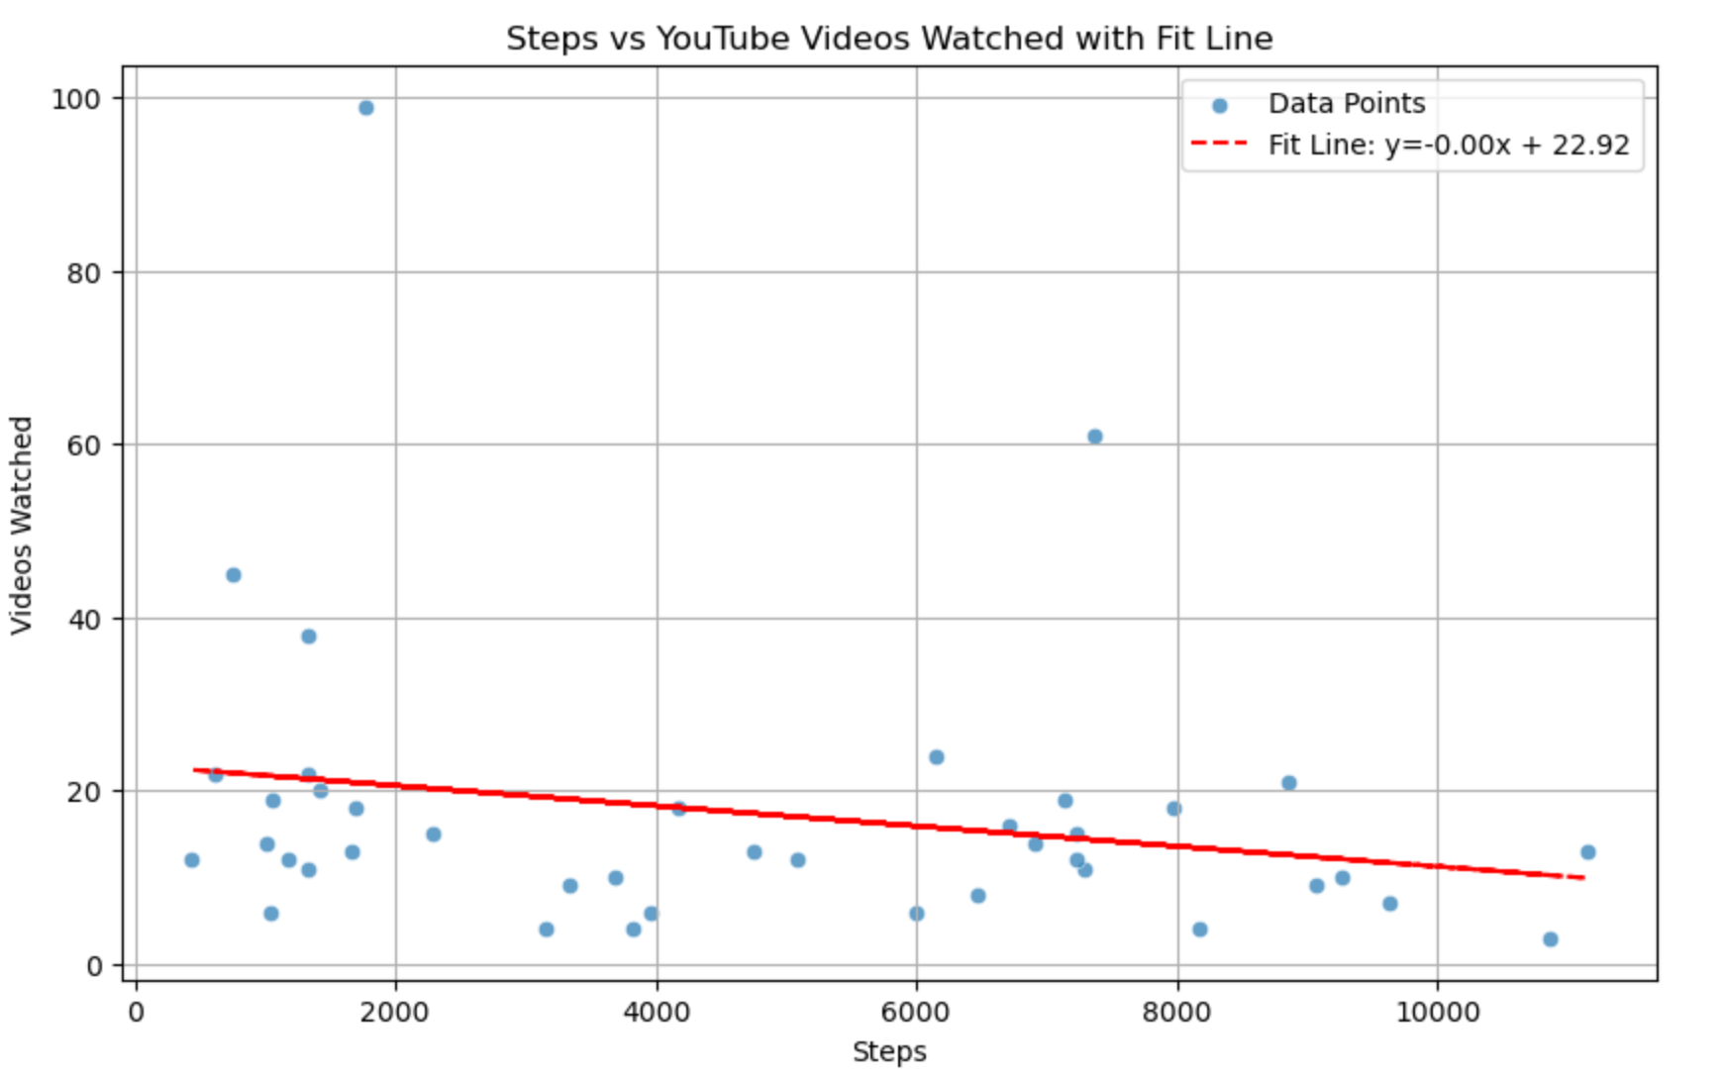
Daily Youtube Usage vs Step Count Best Fit
Pearson Correlation Coefficient (r)
Calculated coefficient reveals the strength and direction of the linear relationship between step counts and YouTube views, yielding r = -0.2208.
Statistical Significance (p-value)
Established p-value of 0.1653 indicates insufficient evidence against H₀, reinforcing the need for further exploration.
Conclusion Insight
Failure to reject the null hypothesis suggests no significant correlation was found, prompting deeper inquiry into the relationship’s complexities.

Slide 10
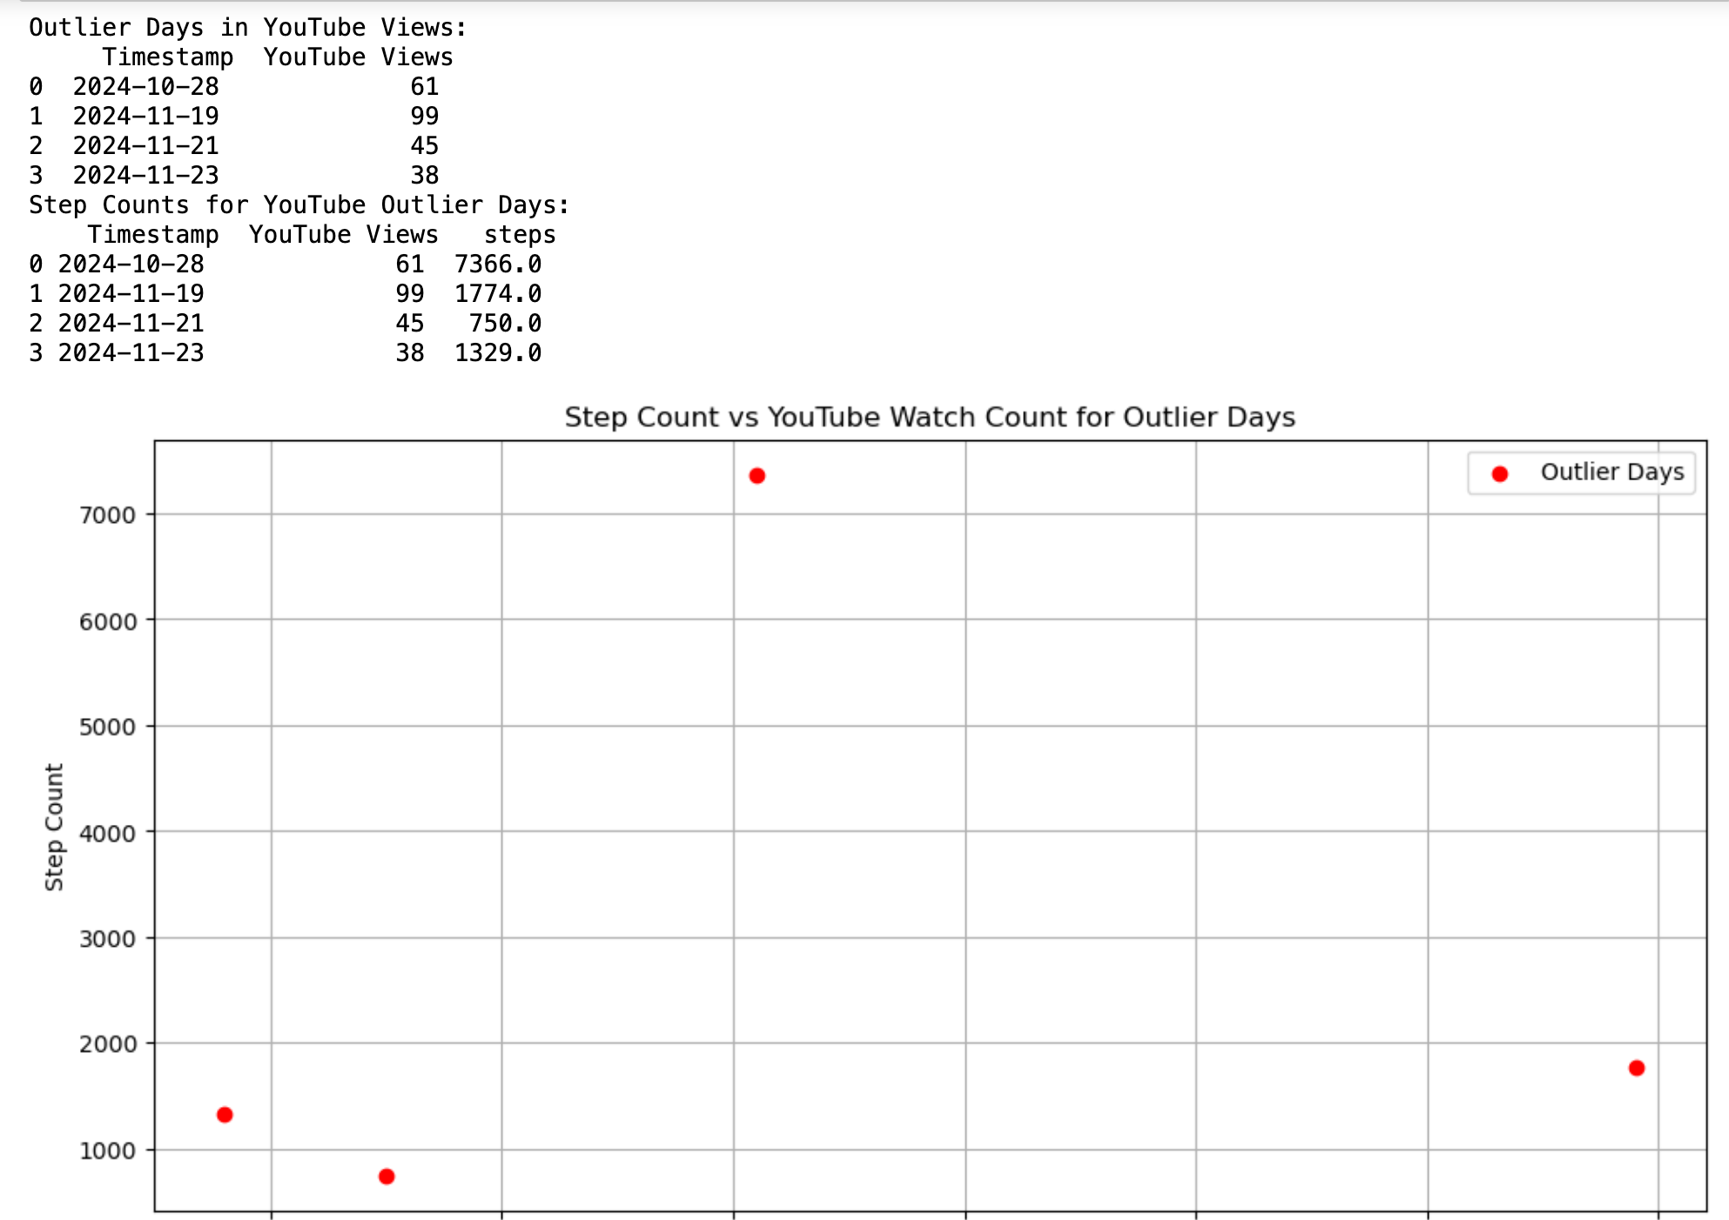
Outlier Analysis
I wanted to find out the outliers and make the correlation analysis excluding the outliers.

Slide 11
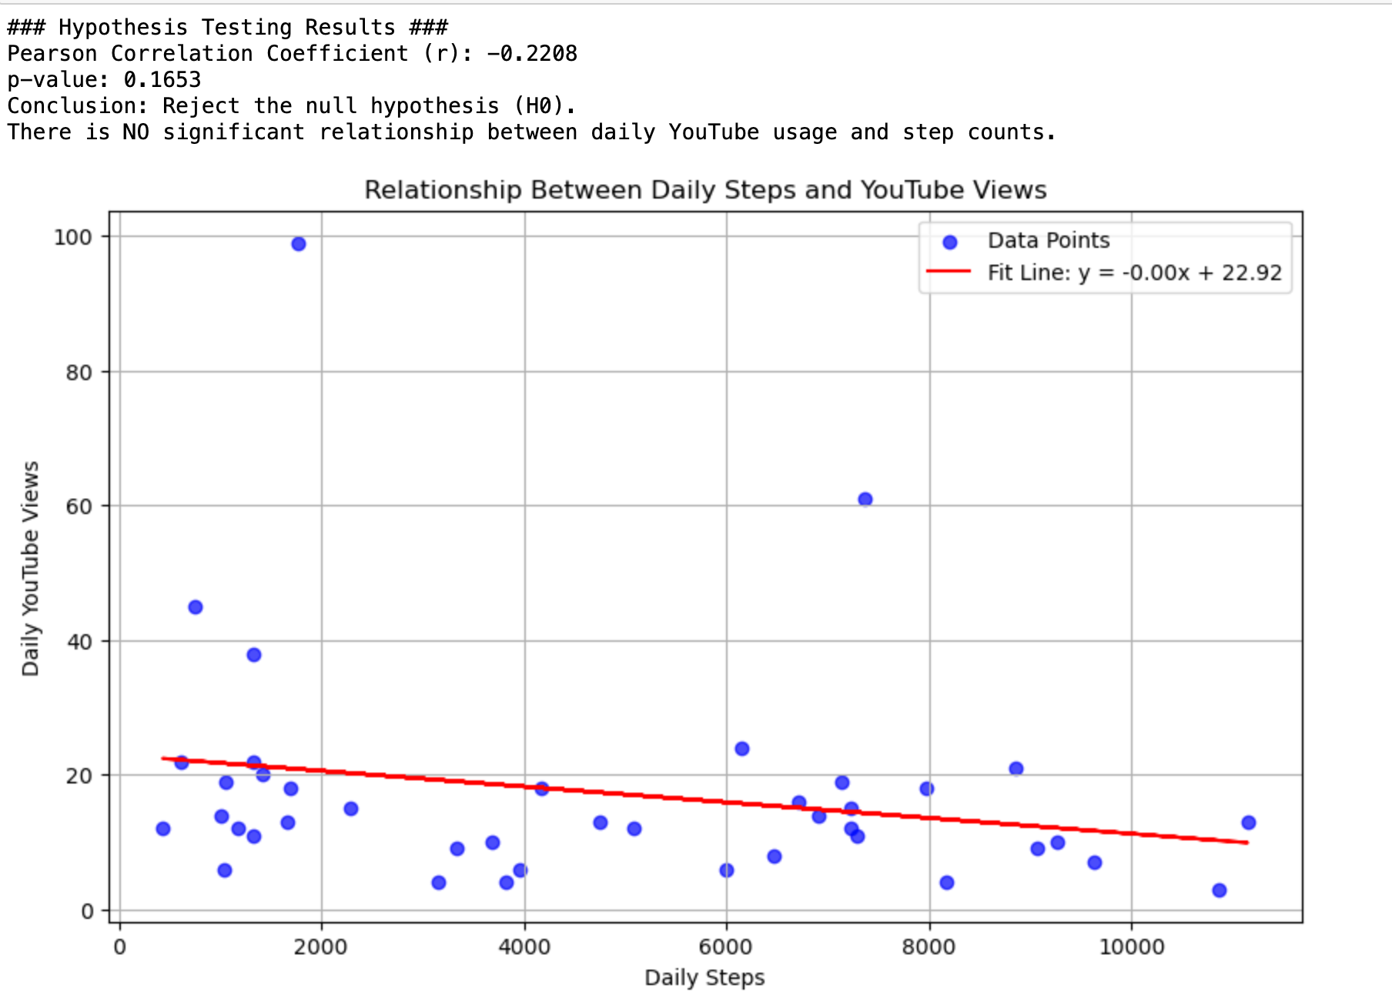
Hypothesis Testing
I used Pearson r Correlation Coefficient to test the hypothesis and the result was failure of the rejection of the null hypothesis.

Slide 12
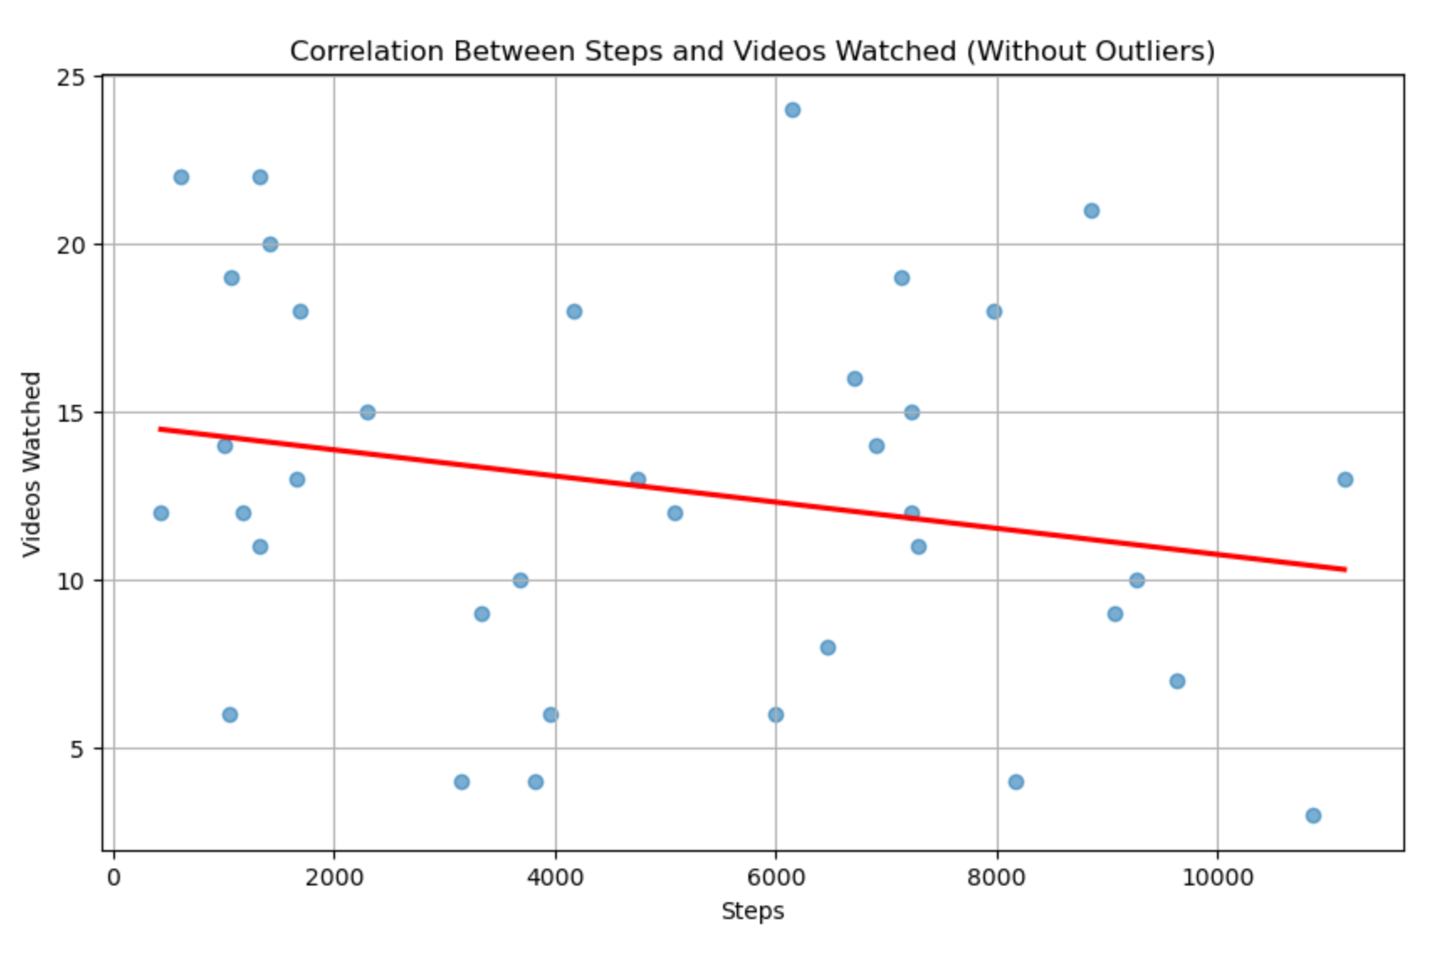
Notes:
In summary, our findings indicate no significant relationship between daily YouTube usage and physical activity levels. We recommend exploring additional factors that could influence this analysis, such as seasonal effects and demographic variations.

Slide 13
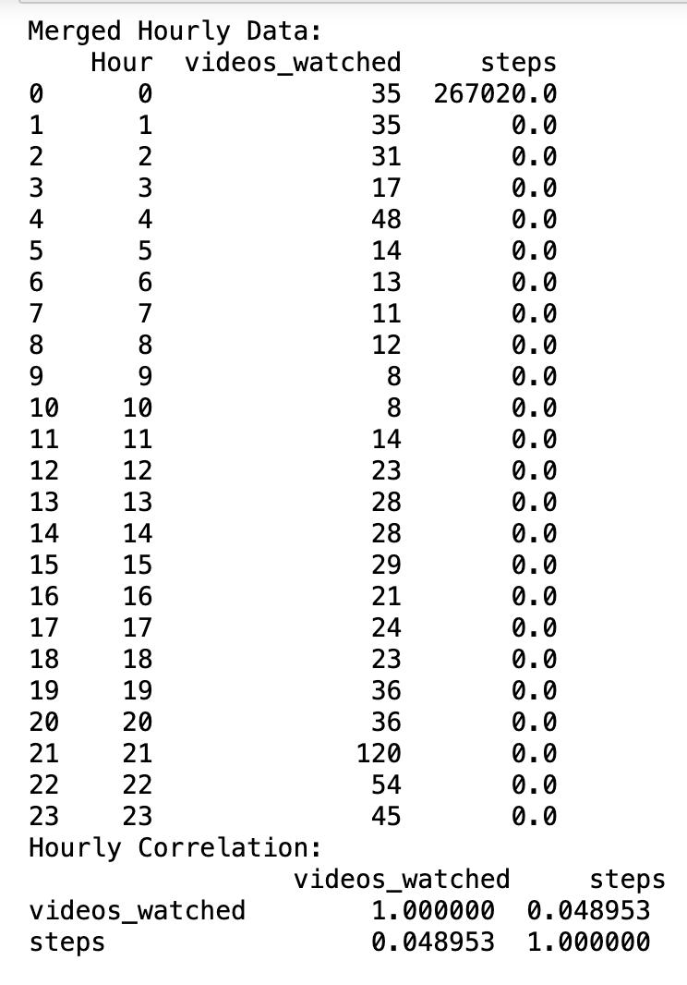
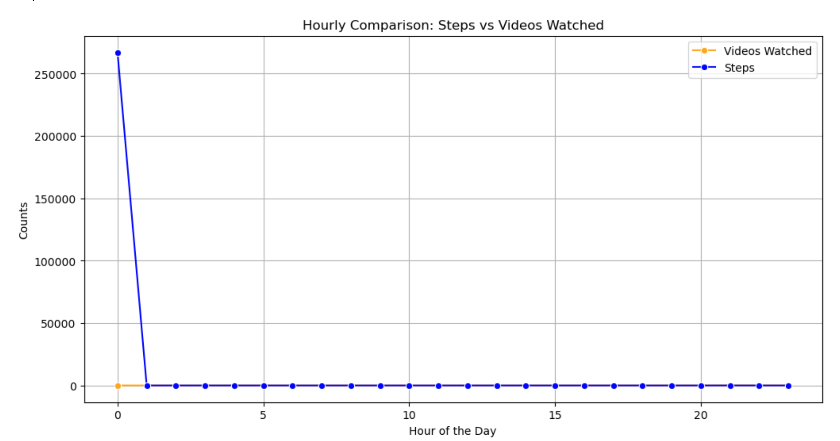
Future Work
I tried to use hourly data for a deeper analysis but the step count data wasn’t available for such analysis so future work can be done on the hourly youtube usage vs step count.

Slide 14
Conclusion While the analysis shows some patterns in YouTube usage and step counts, no significant statistical relationship was found between the two variables. This indicates that the two behaviors are likely independent under the observed conditions.

